Slide 1
Named Entity Recognition (NER)
Diksha Bhushan Waghmare
BugendaiTech Data Science Intern
Team Ayush

Slide 2
Speech Data
Speech was downloaded from PIB in PDF format for year 2022. To make data more manageable for extracted entities we are considering text from the first two pages. Applying different NER techniques and analyzing the same. Few steps are given below.
Extract the text data from pdf and clean it.
Tokenize the text (words or sentences) and Pos Tag it.
NER Using NLTK Chunking (word based tokenization and keeping binary to True)
NER Using NLTK Chunking (word based tokenization and keeping binary to False)
NER Using NLTK Chunking (sentence based tokenization and keeping binary to True)
NER Using NLTK Chunking (sentence based tokenization and keeping binary to False)
NER Using Spacy (Model : en_core_web_md )
NER Using Spacy Transformers (Model : en_core_web_trf)

Slide 3
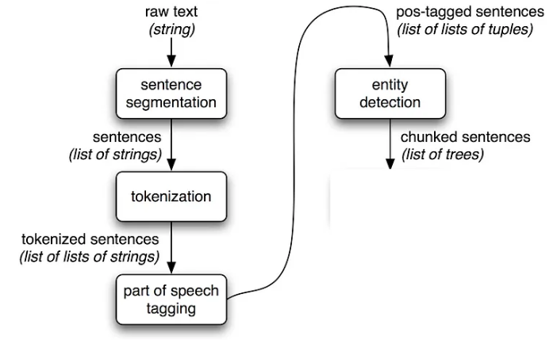
NER using NLTK chunking
Basic flow for NER using NLTK chunking as below.
One of the argument in ne_chunk is “binary”. If its true we will get the data with particular word is named entity (NE). And if its false we will get the chunks with label with different entity names. This might impact the recognition of entities.
Recognition of entities can be impacted by how we tokenize the text (words or sentences). Sentence provide more context , so they might turn out be more efficient to recognize entities.

Slide 4
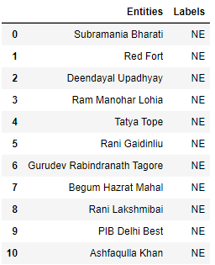
NER using NLTK chunking (word based tokenization and keeping binary to True)
Since Binary argument is True, we will get the information that particular words are NE or not. We will not get specific labels.
From the text we are examining the algorithm fetched 43 entities. Seems it has failed to detect the Dates as entity.
It has identified all the names of person correctly as NE

Slide 5
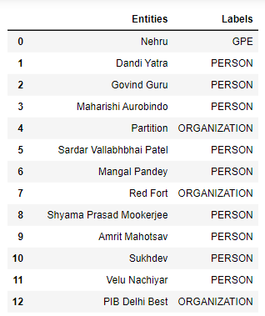
NER using NLTK chunking (word based tokenization and keeping binary to False)
Since Binary argument is False, we will get the specific labels for the entity.
From the text we are examining the algorithm fetched 45 entities. Seems it has failed to detect the Dates as entity once again.
It has identified all the names of person correctly as NE.
It has failed to identify Red Fort, Partition correctly. These are LOC and EVENT.

Slide 6
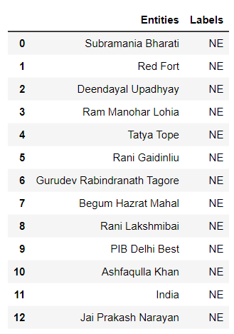
NER using NLTK chunking (sentence based tokenization and keeping binary to True)
Since Binary argument is True, we will get the information that particular words are NE or not. We will not get specific labels.
From the text we are examining the algorithm fetched 44 entities. Seems it has failed to detect the Dates as entity.
It has identified all the names of person correctly as NE
For this particular text we have not observed any difference between results of word based or sentence based tokenization.

Slide 7
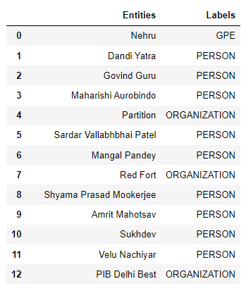
NER using NLTK chunking (sentence based tokenization and keeping binary to False)
Since Binary argument is False, we will get the specific labels for the entity.
From the text we are examining the algorithm fetched 45 entities. Seems it has failed to detect the Dates as entity.
It has identified all the names of person correctly as NE
It has failed to identify Red Fort, Partition correctly. These are LOC and EVENT.
For this particular text we have not observed any difference between results of word based or sentence based tokenization.

Slide 8
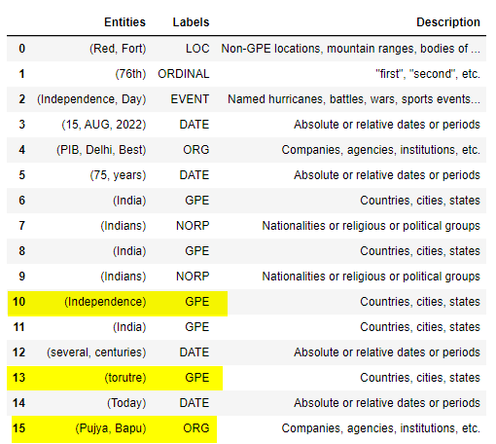
NER using Spacy
Spacy has three pre-trained language models (english).
  en_core_web_sm -- small language model
  en_core_web_md -- medium language model
  en_core_web_lg -- large language model
  All these three models has same accuracy level as per spacy documentation but differ in cpu/memory usage.
We have used medium language model for NER.
It has better results than NLTK. It has identified locations, Events, Dates, Organizations better.
It has failed cases as well highlighted in yellow. It has identified “Independence”, “torture” as GPE. And “Pujya Bapu” as organization.
Let us explore different model and check if we get better results

Slide 9
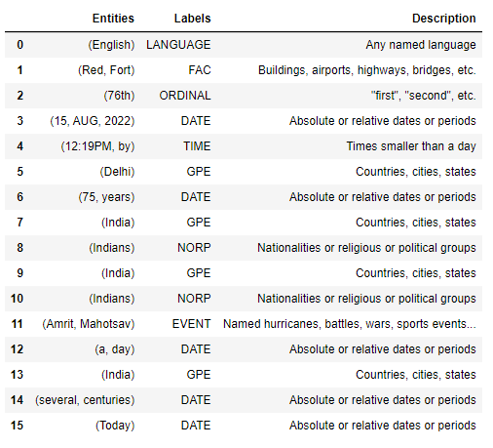
NER using Spacy transformers pipeline
Spacy has en_core_web_trf English transformer pipeline models.
It has better accuracy than English pipeline used earlier.
It has accurately identified all the named entities in given text.
Displayed all entities in text using displacy render on coming slides.

Slide 10
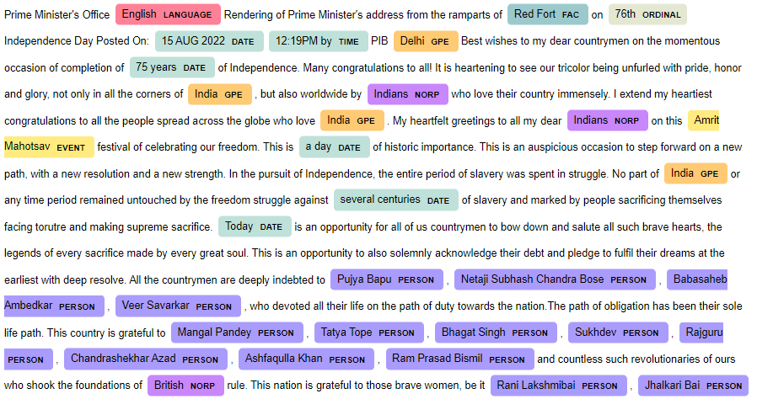
NER using Spacy transformers pipeline

Slide 11
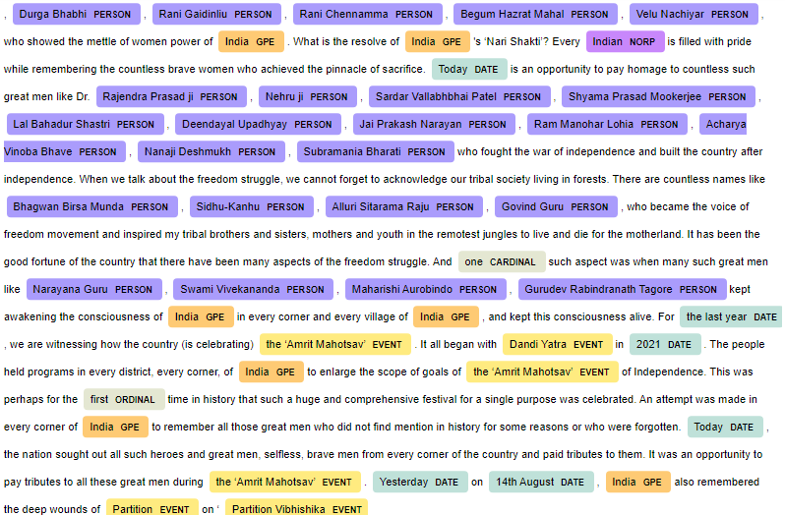
NER using Spacy transformers pipeline

Slide 12
Conclusion
There are different techniques to do NER. We have explored two ways, using NLTK and Spacy
Observed that these models are not 100% accurate while recognizing NE. We can either update the models using rule based entity addition in existing models or re-train it using the data we have. We have not yet explored these two ways of updating the models.
Found out that Spacy transformers pipeline worked best to identify the NE for given text.

Slide 13
Thank You

